Slide 1







My dream job is being a cook!
I am Alan Romeo Delzoto and this is my presentation

Slide 2
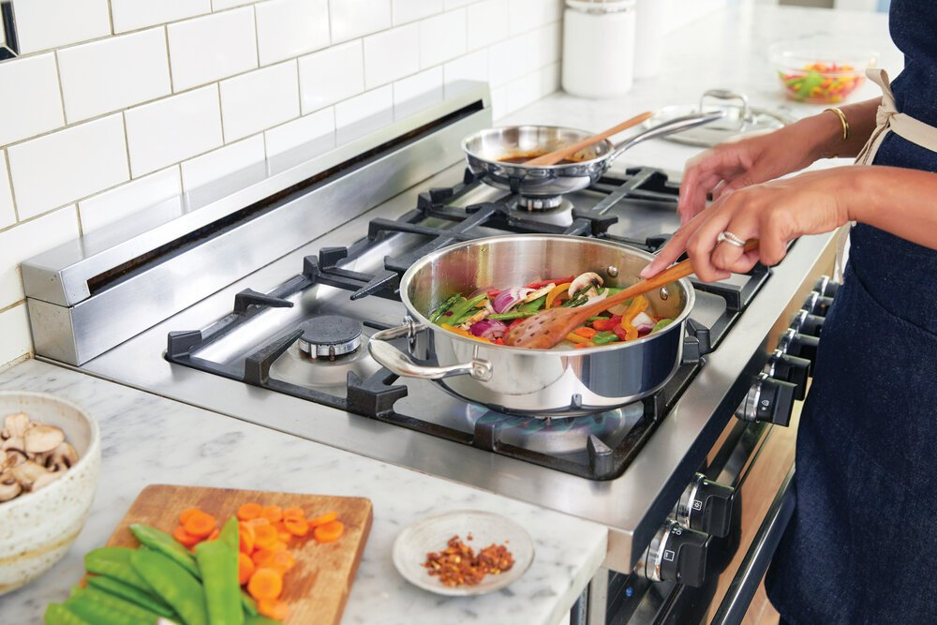
Introduction
My dream job is being a cook, i really like cooking. I think is a form to demonstrate your art with food.
You can combine your creativity and passion in the kitchen and for me the best feeling about cook is seeing to my girlfriend, fathers, friends enjoying my food and that is why i really like cooking

Slide 3
Education and courses
When i started to learn for myself i saw a lot of videos in youtube, i like a lot these videos for exemple i learned how to do fried chicken, lasaña, boloñesa, etc…
For being a professional cook you will need Professional training (FP medio y superior)
And something that I consider really important for being a professional cook or chef is try it for yourself, do a lot of stupid things but don’t be afraid, is really important not being afraid and try new recipes by yourself and learn with your mistakes.

Slide 4
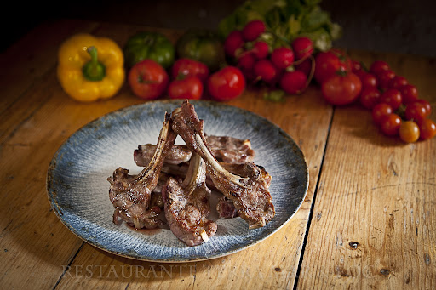
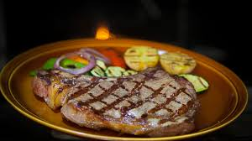
Work experience
I’ve worked in a restaurant of Alaró, is really near of my house.
His name is Terra, Mar i Foc, I worked as a waiter and assistant in kitchen.
As a waiter, well you know, i’ve served the clients and that’s it.
But as an assistant of kitchen is really different, is really hard and fast, you can’t stop, but i really enjoyed that work!

Slide 5

Skills Developed
I developed better cooking skills, cutting with the knife, having more speed, more patience, better time perception, and have less fear, and for me something that is really important is having a steadier hand.

Slide 6
Financial aspect
I think that you have a really worthy pay, but it's a really hard job, but i mean, is so hard, you can’t stop. If i am honest, is not my job, is very stressful and for me it’s not worth it, but if you don’t care about the stress is a nice job because of the pay.

Slide 7
Career Goals
My goal with this career is to open my own restaurant, i want to be my own boss and cook my own food and unique recipes, i think i can be a freelancer by myself, and that's is my dream.

Slide 8

Thanks!

